Slide 1
CSD 1451

Slide 2
Interpersonal Skills Part 1

Slide 3
Frameworks
Of Understanding
For Action

Slide 4
Understanding

Slide 5
Some Frameworks of Understanding
Clifton StrengthsFinder
Myer-Briggs Type Indicator (MBTI)
Enneagram

Slide 6
Clifton StrengthsFinder
Created by Donal O.Clifton
Helps uncover the “one true you”
34 Themes of strength spread over 4 Domains :
Executing
Influencing
Relationship Building
Strategic Thinking

Slide 7
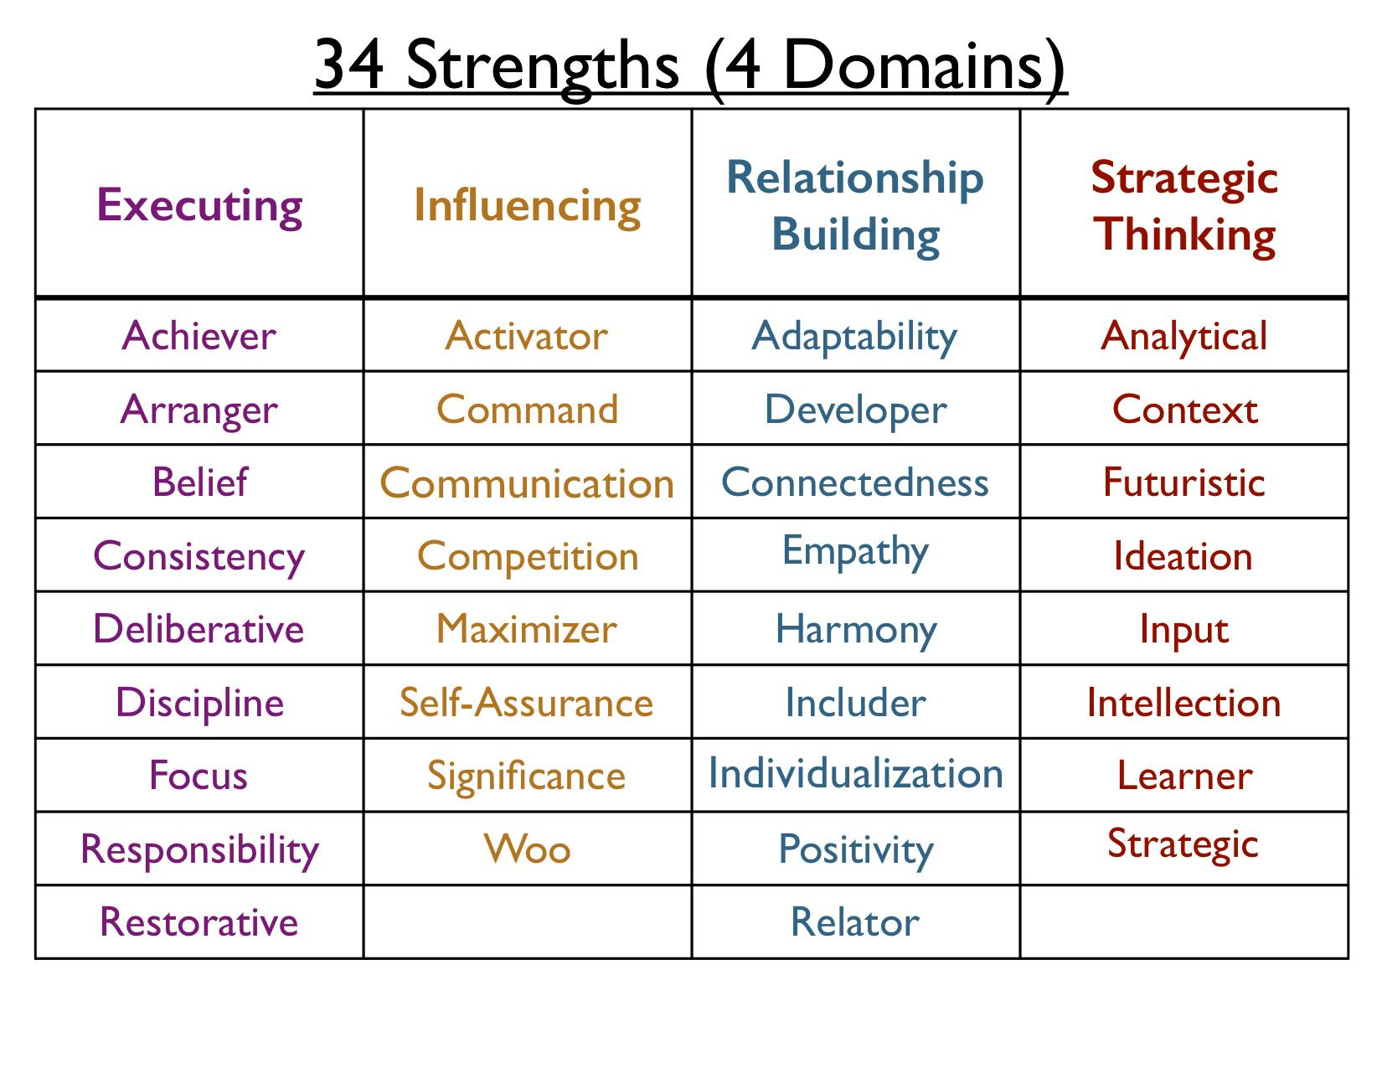

Slide 8
Cliffton StrengthsFinder
Test of 177 Questions
Reveals your unique combination of strengths, normally we focus on the top 5
Up to your own commitment to realize your potential.
There are courses and coaches to help with that too

Slide 9
Myer-Briggs Type Indicator (MBTI)
Based on the theory of psychological types originally developed by Carl Gustav Jung
16 Unique personalities based on 4 fields
Favourite world : Extraversion or Introversion (E or I)
Information Perception : Sensing or Intuition (S or N)
Decisions : Thinking or Feeling (T or F)
Structure : Judging or Perceiving (J or P)
Notes:
For “Structure”, this is the preferred lifestyle method when relating to the outside world

Slide 10
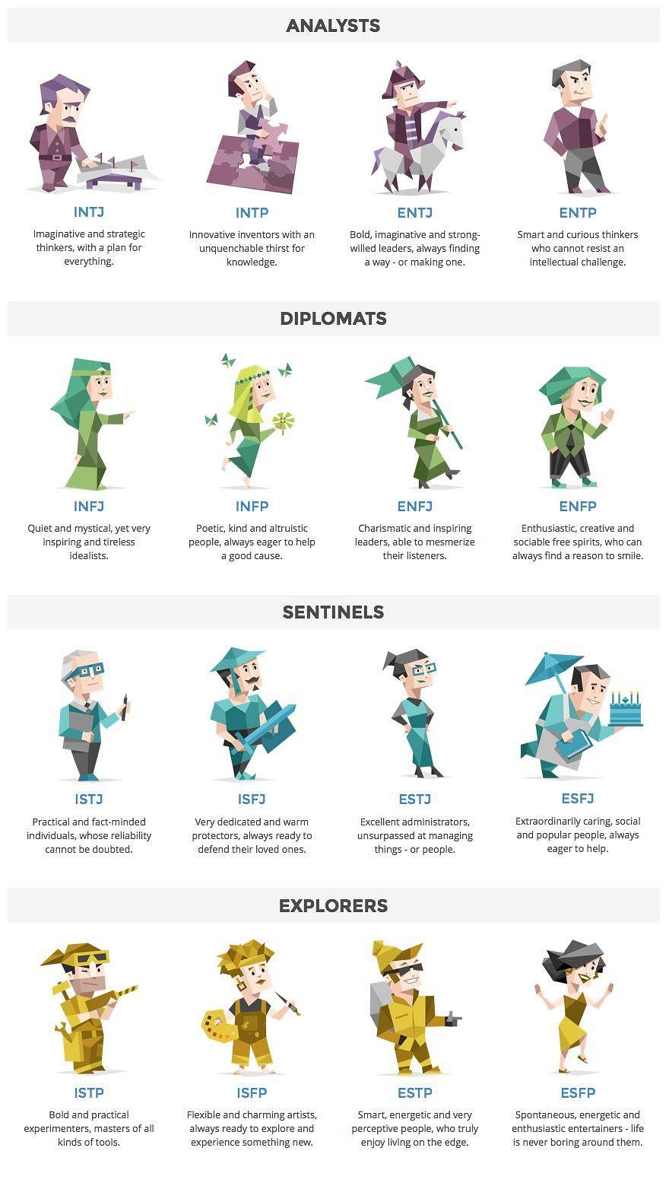

Slide 14
Enneagram
Our focus today

Slide 15
Enneagram
System of personality typing that describes patterns in how people interpret the world and deal with their emotions
Used in businesses to understand workplace interpersonal dynamics

Slide 16
Warning
limited formal research done on the topic
different teachers have different interpretations
Online tests are not very accurate

Slide 17
Enneagram
9 Unique types
Numbers combination of a Stance and Triad
Stance, how we react to information
Triad, how we process/take in information
Three types to each Stance and Triad

Slide 18
No “Good” or “Bad” number
Everyone has their own:
History
Strengths
Short falls
Etc

Slide 19
Find your number
Stance
Triad
Number

Slide 20
Stances – How we react to info
Aggressive
Dependent
Withdrawn

Slide 21
Aggressive
Feeling repressed
Key need is control
Tend to be leaders
Concerned about the future, and have many ideas for how things should be
Have a lot of energy
Can be pushy and unaware of the feelings of others

Slide 22
Dependent
Thinks a lot about relationships and interpersonal dynamics, must do well what others want or expect
Hold high standards and are harsh on themselves when falling short
Have trouble with boundaries, making plans and following through
Opinionated, hold fast to inherited stances and ideas
Comfortable with being 2nd
Gets energy from being with others

Slide 23
Withdrawing
Look within for what they need, do not succumb to peer pressure
Withdrawn under stress, not practiced at standing and speaking up for themselves
Their inner world is the real world, not easy to connect with people outside
Doing repressed
Regret is a common emotion

Slide 24
Triads – How we process info
Thinking
Feeling
Instinctual

Slide 25
Thinking (Head)
Head center
Filter life through an intellectual lens
Motivated by a need for security, fear

Slide 26
Feeling (Heart)
Heart center
Filter life through an emotional lens
Easily access their own feelings

Slide 27
Instinctual (Gut)
Gut Center
Experiences are filtered through the body
A strong intuition informs decisions

Slide 28
Numbers
Thinking (Head)
Aggressive – 7
Dependent – 6
Withdrawn – 5
Feeling (Heart)
Aggressive – 3
Dependent – 2
Withdrawn – 4
Instinctual (Gut)
Aggressive – 8
Dependent – 1
Withdrawn – 9

Slide 29
Numbers
The Perfectionist
The Giver
The Performer
The Romantic
The Observer
The Questioner
The Enthusiast
The Challenger
The Peacemaker

Slide 30
The following….
Descriptions of each number
Do not need to agree with all points to be of that number
Just note which number speaks most true to you.

Slide 31
1 The Perfectionist
Gut & Dependent
Internalizes anger, resents
Need to be perfect, think they are lacking, inner voices work against them
Criticism does not work well with them
Driven to correct things based on their high standards
Feel terrible from releasing anger
Notes:
Strong voice of an inner critic in their heads.

Slide 32
2 The Giver/Helper
Heart & Dependent
Need to be needed, approval and gratitude
Puts all power to giving altruistically
Fatigue from giving too much, feeling taken for granted
Do well with people oriented task
Usually feels what others are feeling and express those feelings instead of their own

Slide 33
3 The Performer, Achiever
Heart & Aggressive
Need to see themselves as successful, goal oriented
Feels are hidden, deemed as hurdles
Like and good at multi-tasking
Motivated by external applause, try to be what they think we want them to be
Lots of energy
Do not really know who they are

Slide 34
4 The Romantic, Individualist
Heart Triad & Withdrawn
Most complex, most unique, few in the world
Need to be seen as special
Feel abandoned, and something is missing in them
Comfortable with melancholy, sad stories, tragedy
Want to know why they are here, where they belong
Focus on what is missing

Slide 35
5 The Observer, Investigator
Head & Withdrawn
Need space and to understand
Want resources to not have to rely on others, hoards
Want control, gained through knowledge
Most emotionally detached, dislikes that interaction
Like new experiences and adventures
Loyal and can keep secrets

Slide 36
6 The Questioner, Loyalist
Head & Dependent
Needs to feel certain and secured, sense of control
Likes order, plans, rules
Doubt themselves, think they need courage
Manages fears with worst case scenario planning
Asks a lot of questions
Very good team players
Might procrastinate, believe thinking & doing is the same

Slide 37
7 The Enthusiast
Head & Aggressive
Take delight in the very best possibility
Need to avoid pain and be happy, masters of denial
Very charming, can uplift people, capable of dealing with hard stuff
Need to be spontaneous, cannot really sit still
Commit deeply in relationships

Slide 38
8 The Challenger
Gut & Aggressive
Power oriented, avoids being controlled
Independent thinkers, see things in extremes
Passion is anger, externalises anger
Want to see others’ purposes, respect people willing to go all out
Do not do well with mixed messages
Lots of physical energy, seldom afraid

Slide 39
9 The Mediator, Peacemaker
Gut & Withdrawn
Avoids conflict and being affected by life, peace
Always sees two sides of things, ambivalent
Can be passive aggressive
Not prone to peer pressure
Start slow and taper off
Self forgetting, personal agenda threatens peace
Laid back, easy going and easy to be with

Slide 40
Knowing Yourself and Others
Identify behaviours in times of stress and security
Identify passions and motivations
Identify methods for care and transformation

